Slide 1
Exploratory Data Analysis of Bank Marketing Campaign
Understanding Customer Response Patterns
Name: Mitra Manohar Sai Katta
Date: 17/05/2024

Slide 2
Introduction
Brief overview of the bank marketing campaign dataset
Importance of exploratory data analysis (EDA) in understanding customer behavior

Slide 3
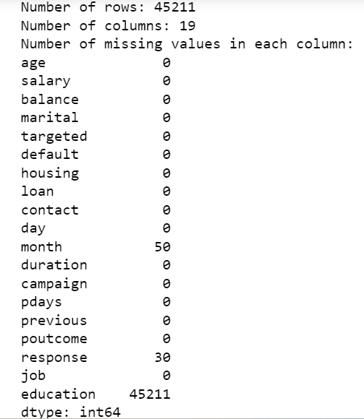
Data Overview
Summary statistics of the dataset (number of rows, columns, missing values)
Sample records from the dataset

Slide 4
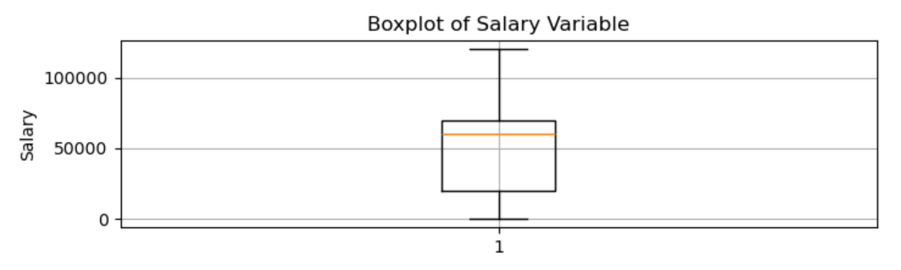
Univariate Analysis
Segment 1: Data Types
Description of different data types in the dataset
Segment 2: Numeric-Unordered Analysis
Histograms and descriptive statistics of numeric variables like salary, balance, and age

Slide 5
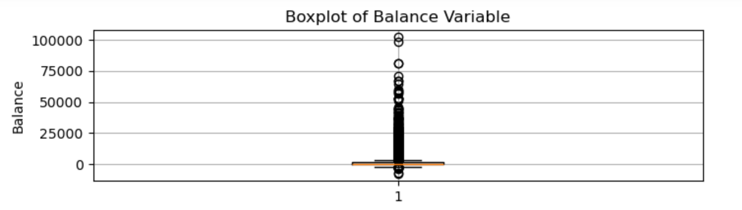
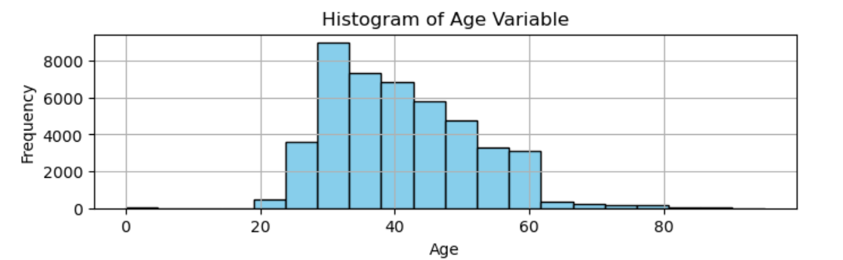
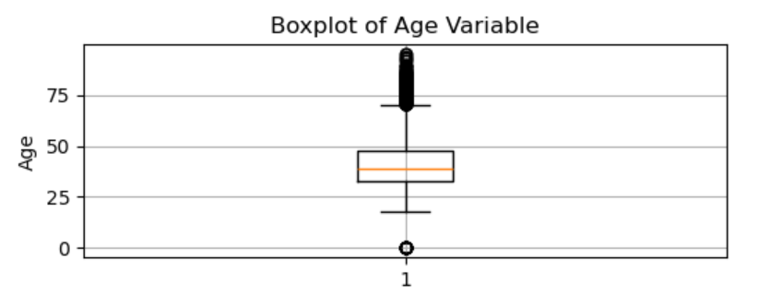
Univariate Analysis (Contd.)

Slide 6
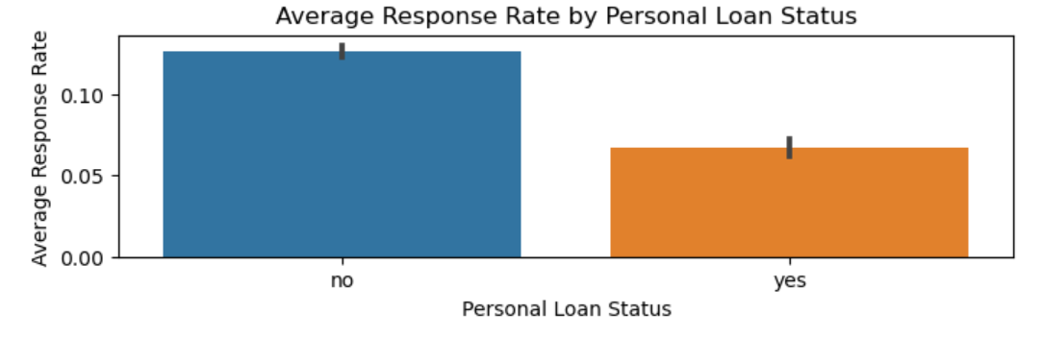
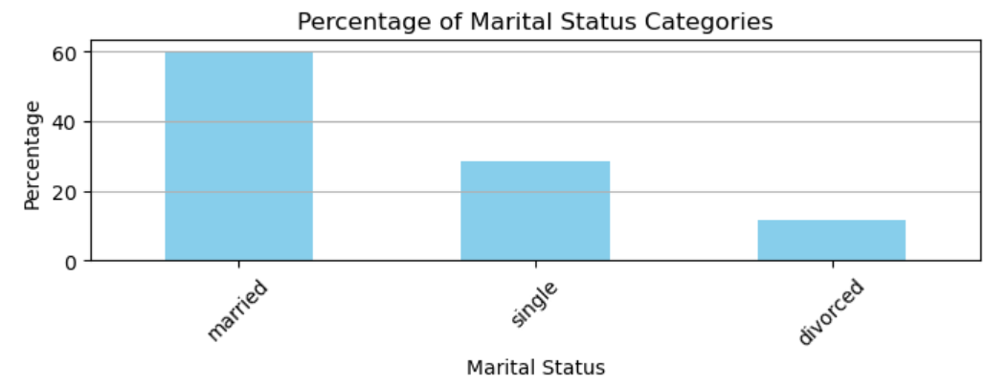
Univariate Analysis (contd.)
Segment 3: Numeric-Categorical Analysis
Bar graphs showing response rates by education, marital status, loan status, etc.

Slide 7
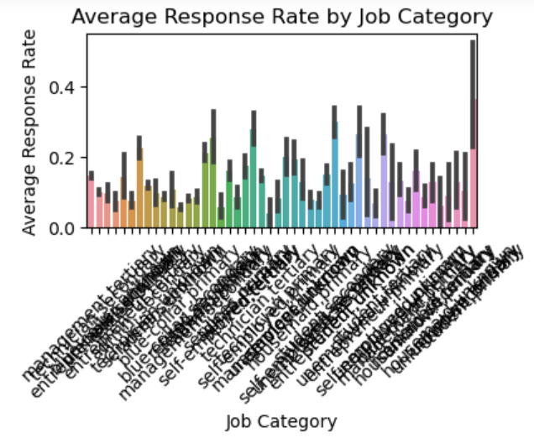
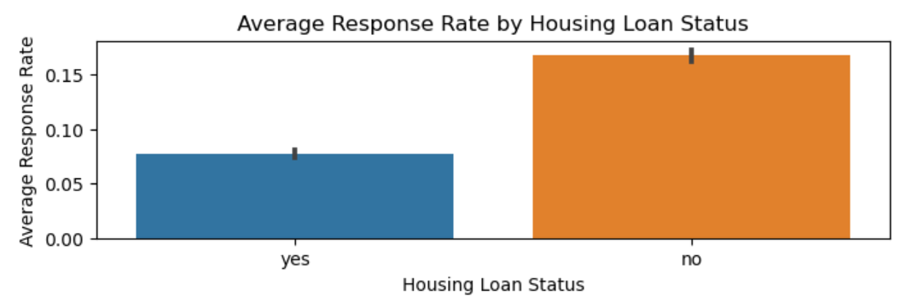
Univariate Analysis (contd.)

Slide 8
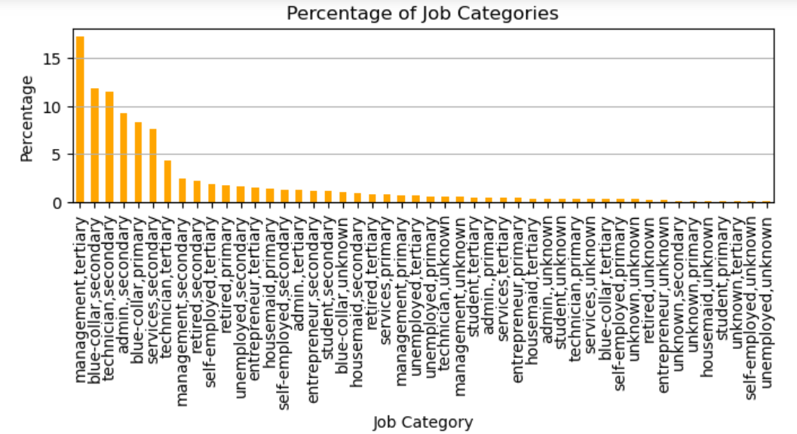
Univariate Analysis (contd.)
bar graph of percentage job categories

Slide 9
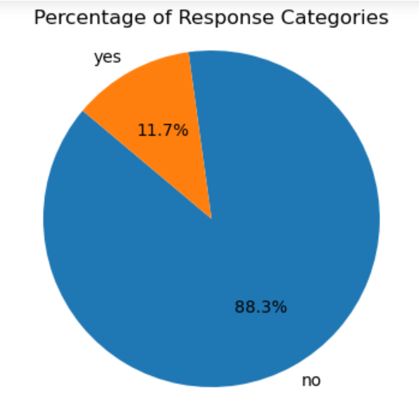
Univariate Analysis (contd.)
Segment 4: Categorical-Unordered Analysis
Pie charts representing the distribution of education, job, marital status, etc.

Slide 10
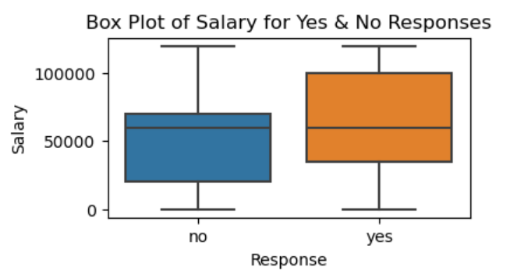
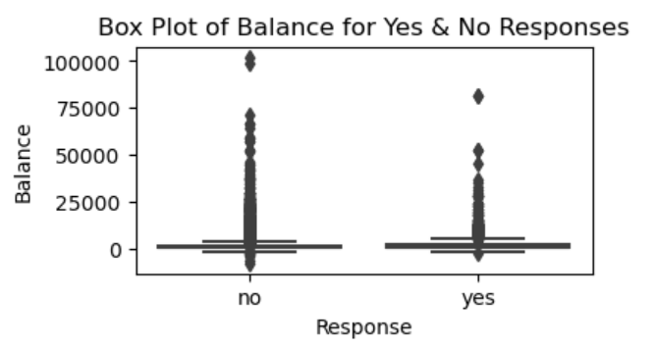
Bivariate and Multivariate Analysis
Segment 1: Numeric-Numeric Analysis
Scatter plots, correlation matrices, pair plots of numeric variables
Segment 2: Numeric-Categorical Analysis
Box plots, bar graphs showing salary vs response, balance vs response, etc.

Slide 11
Bivariate and Multivariate Analysis
Segment 3: Categorical-Categorical Analysis
Heatmaps showing education vs marital vs response, job vs marital vs response, etc.
PENDING …

Slide 12
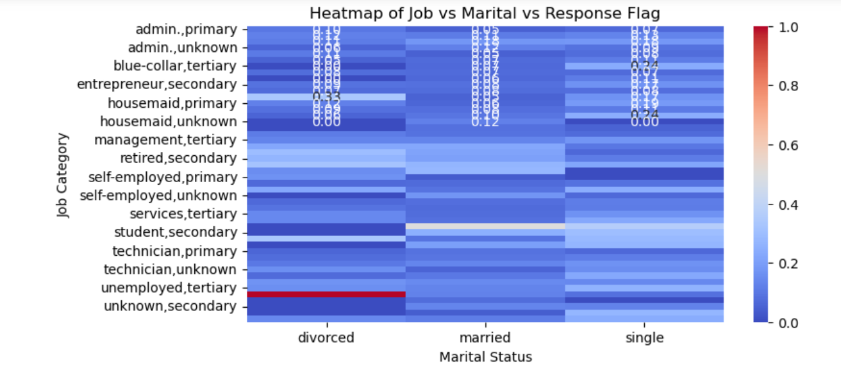
Bivariate and Multivariate Analysis
Segment 3: Categorical-Categorical Analysis
Heatmap of job vs marital vs response

Slide 13
Conclusion
Summary of key findings from the analysis
Recommendations for future marketing campaigns based on insights gained

Slide 14
References
List of data sources, libraries used, and any external references
You can create each slide using PowerPoint or any other presentation software, adding relevant visuals (graphs, tables) and annotations to explain the analysis effectively. Ensure the presentation is concise, visually appealing, and easy to understand for your audience.

